Slide 1
Lecture03 Decision Stuctures
The if Statement
The if-else Statement
Comparing Strings
Nested Decision Structures and the if-elif-else Statement
Logical Operators
Boolean Variables

Slide 2
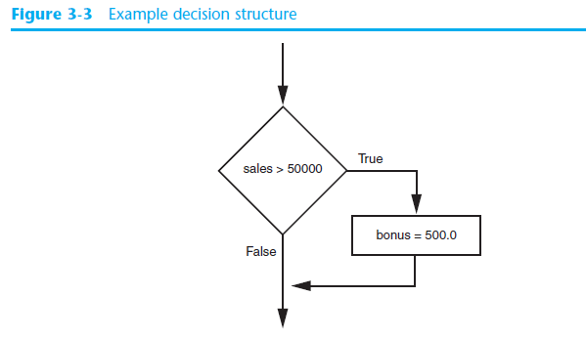
The if Statement
Using a Boolean expression with the > relational operator

Slide 3
The if Statement (cont’d.)
Python syntax:
  if condition:
    Statement
    Statement

Slide 4
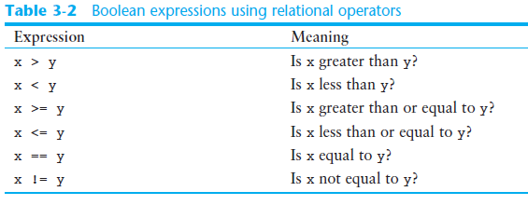
Boolean Expressions and Relational Operators (cont’d.)

Slide 5
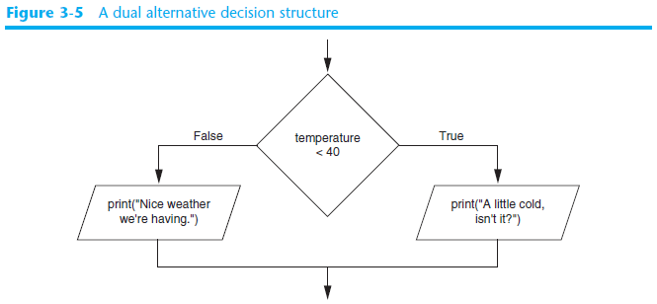
The if-else Statement

Slide 6
The if-else Statement
Dual alternative decision structure: two possible paths of execution
  One is taken if the condition is true, and the other if the condition is false
  Syntax: if condition:
    statements
    else:
    other statements

Slide 7
Nested Decision Structures
A decision structure can be nested inside another decision structure
  Commonly needed in programs
  Example:
    Determine if someone qualifies for a loan, they must meet two conditions:
      Must earn at least $30,000/year
      Must have been employed for at least two years
    Check first condition, and if it is true, check second condition

Slide 8
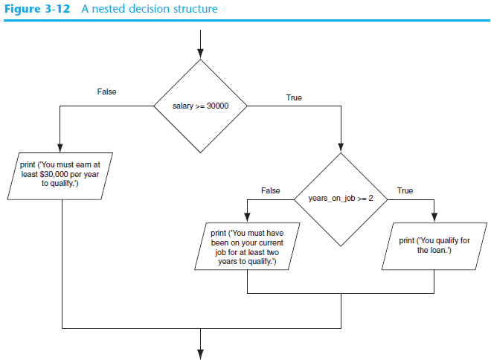

Slide 9
Nested Decision Structures
Important to use proper indentation in a nested decision structure
  Important for Python interpreter
  Makes code more readable for programmer
  Rules for writing nested if statements:
    else clause should align with matching if clause
    Statements in each block must be consistently indented

Slide 10
The if-elif-else Statement
if-elif-else statement: special version of a decision structure
  Makes logic of nested decision structures simpler to write
    Can include multiple elif statements
  Syntax:
if condition_1:
statement(s)
elif condition_2:
statement(s)
elif condition_3:
statement(s)
else
statement(s)
Insert as many elif clauses
as necessary.

Slide 11
The if-elif-else Statement
Alignment used with if-elif-else statement:
  if, elif, and else clauses are all aligned
  Conditionally executed blocks are consistently indented

Slide 12
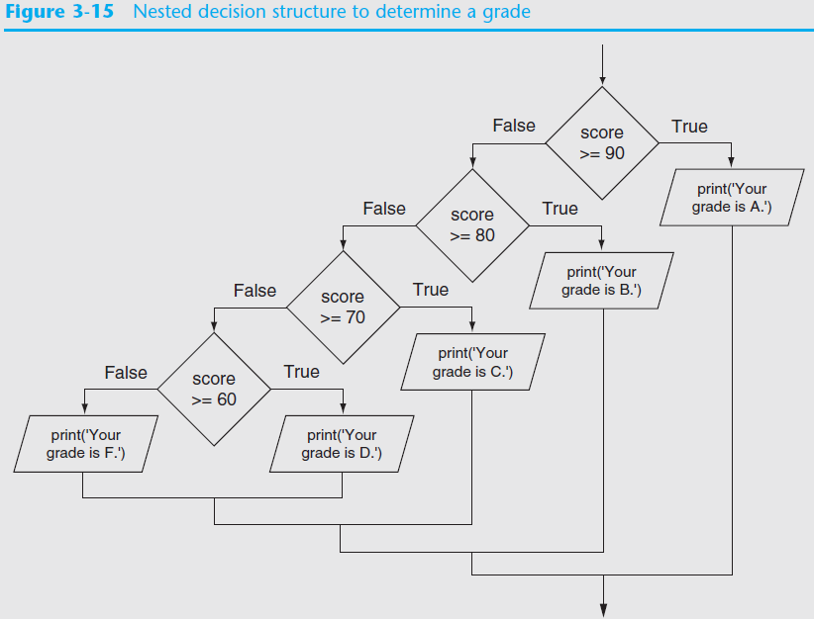

Slide 13
Logical Operators
Logical operators: operators that can be used to create complex Boolean expressions
  and operator and or operator: binary operators, connect two Boolean expressions into a compound Boolean expression
  not operator: unary operator, reverses the truth of its Boolean operand

Slide 14
The and Operator
Takes two Boolean expressions as operands
  Creates compound Boolean expression that is true only when both sub expressions are true
  Can be used to simplify nested decision structures
Truth table for
the and operator
Expression | Value of the Expression
false and false | false
false and true | false
true and false | false
true and true | true

Slide 15
The or Operator
Takes two Boolean expressions as operands
  Creates compound Boolean expression that is true when either of the sub expressions is true
  Can be used to simplify nested decision structures
Truth table for
the or operator
Expression | Value of the Expression
false and false | false
false and true | true
true and false | true
true and true | true

Slide 16
The not Operator
Takes one Boolean expressions as operand and reverses its logical value
  Sometimes it may be necessary to place parentheses around an expression to clarify to what you are applying the not operator
Truth table for the not operator
Expression | Value of the Expression
true | false
false | true

Slide 17

Checking Numeric Ranges with Logical Operators
To determine whether a numeric value is within a specific range of values, use and
  Example: x >= 10 and x <= 20
To determine whether a numeric value is outside of a specific range of values, use or
  Example: x < 10 or x > 20

Slide 18
Boolean Variables
Boolean variable: references one of two values, True or False
  Represented by bool data type
Commonly used as flags
  Flag: variable that signals when some condition exists in a program
    Flag set to False → condition does not exist
    Flag set to True → condition exists

Slide 19
Summary
This chapter covered:
  Decision structures, including:
    Single alternative decision structures
    Dual alternative decision structures
    Nested decision structures
  Relational operators and logical operators as used in creating Boolean expressions
  Boolean variables

